Slide 1
Network security entails securing data against attacks while it is in transit on a network.
To achieve this goal, many real-time security protocols have been designed.
Such protocol needs to provide at least the following primary objectives −
The parties can negotiate interactively to authenticate each other.
Establish a secret session key before exchanging information on network.

Slide 2
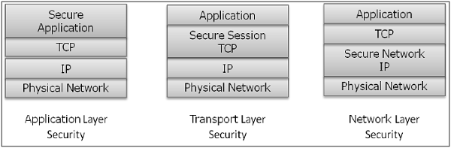
Exchange the information in encrypted form.
Interestingly, these protocols work at different layers of networking model.
For example, S/MIME protocol works at Application layer, SSL protocol is developed to work at transport layer,
and IPsec protocol works at Network layer.

Slide 3
E-mail Security:
Nowadays, e-mail has become very widely used network application. Let’s briefly discuss the e-mail infrastructure before proceeding to know about e-mail security protocols.

Slide 4
E-mail Infrastructure:
The simplest way of sending an e-mail would be sending a message directly from the sender’s machine to the recipient’s machine. In this case, it is essential for both the machines to be running on the network simultaneously. However, this setup is impractical as users may occasionally connect their machines to the network.

Slide 5
In general, the e-mail infrastructure consists of a mesh of mail servers, also termed as Message Transfer Agents (MTAs) and client machines running an e-mail program comprising of User Agent (UA) and local MTA.
Typically, an e-mail message gets forwarded from its UA, goes through the mesh of MTAs and finally reaches the UA on the recipient’s machine.

Slide 6
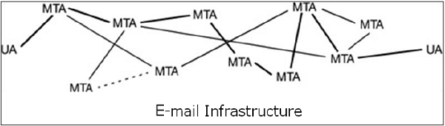

Slide 7
The protocols used for e-mail are as follows :
Simple mail Transfer Protocol (SMTP) used for forwarding e-mail messages.
Post Office Protocol (POP) and Internet Message Access Protocol (IMAP) are used to retrieve the messages by recipient from the server.

Slide 8
MIME
Basic Internet e-mail standard was written in 1982 and it describes the format of e-mail message exchanged on the Internet. It mainly supports e-mail message written as text in basic Roman alphabet.
By 1992, the need was felt to improve the same. Hence, an additional standard Multipurpose Internet Mail Extensions (MIME) was defined. It is a set of extensions to the basic Internet E-mail standard.

Slide 9
MIME provides an ability to send e-mail using characters other than those of the basic Roman alphabet such as Cyrillic alphabet (used in Russian), the Greek alphabet, or even the ideographic characters of Chinese.
Another need fulfilled by MIME is to send non-text contents, such as images or video clips. Due to this features, the MIME standard became widely adopted with SMTP for e-mail communication.

Slide 10
E-Mail Security Services
Growing use of e-mail communication for important and crucial
transactions demands provision of certain fundamental security services as the following −
Confidentiality − E-mail message should not be read by anyone but the intended recipient.
Authentication − E-mail recipient can be sure of the identity of the sender.
Integrity − Assurance to the recipient that the e-mail message has not been altered since it was transmitted by the sender.
Non-repudiation − E-mail recipient is able to prove to a third party that the sender really did send the message.
Proof of submission − E-mail sender gets the confirmation that the message is handed to the mail delivery system.
Proof of delivery − Sender gets a confirmation that the recipient received the message.

Slide 11
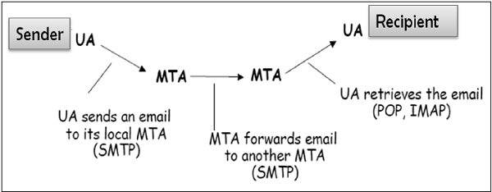
One-to-One E-mail
In this scenario, the sender sends an e-mail message to only one recipient. Usually, not more than two MTA are involved in the communication.

Slide 12
Let’s assume a sender wants to send a confidential e-mail to a recipient. The provision of privacy in this case is achieved as follows −
The sender and receiver have their private-public keys as (S_{PVT}, S_{PUB}) and (R_{PVT}, R_{PUB}) respectively.
The sender generates a secret symmetric key, K_{S} for encryption. Though the sender could have used R_{PUB} for encryption, a symmetric key is used to achieve faster encryption and decryption.
The sender encrypts message with key K_{S} and also encrypts K_{S} with public key of the recipient, R_{PUB}.
The sender sends encrypted message and encrypted K_{S} to the recipient.
The recipient first obtains K_{S} by decrypting encoded K_{S} using his private key, R_{PVT}.
The recipient then decrypts message using the symmetric key, K_{S}.

Slide 13
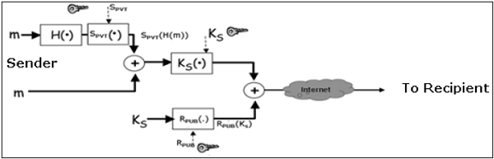
If message integrity, authentication, and non-repudiation services are also needed in this scenario, the following steps are added to the above process.
The sender produces hash of message and digitally signs this hash with his private key, S_{PVT}.
The sender sends this signed hash to the recipient along with other components.

Slide 14
The recipient uses public key S_{PUB} and extracts the hash received under the sender’s signature.
The recipient then hashes the decrypted message and now compares the two hash values. If they match, message integrity is considered to be achieved.
Also, the recipient is sure that the message is sent by the sender (authentication). And lastly, the sender cannot deny that he did not send the message (non-repudiation).

Slide 15
One-to-Multiple Recipients E-mail
In this scenario, the sender sends an e-mail message to two or more recipients.
The list is managed by the sender’s e-mail program (UA + local MTA).
All recipients get the same message.
Let’s assume, the sender wants to send confidential e-mail to many recipients
(say R1, R2, and R3).
The provision of privacy in this case is achieved as follows −
The sender and all recipients have their own pair of private-public keys.
The sender generates a secret symmetric key, K_{s} and encrypts the message with this key.
The sender then encrypts K_{S} multiple times with public keys of R1, R2, and R3,
getting R1_{PUB}(K_{S}), R2_{PUB}(K_{S}), and R3_{PUB}(K_{S}).

Slide 16
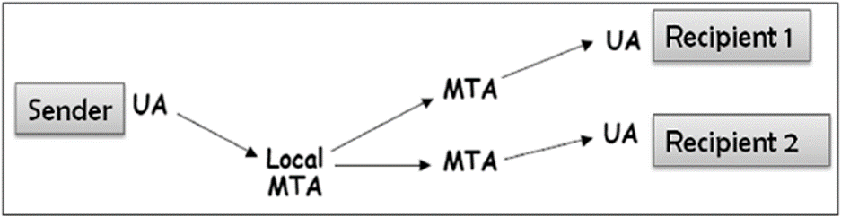
The sender sends encrypted message and corresponding encrypted K_{S} to the recipient.
For example, recipient 1 (R1) receives encrypted message and R1_{PUB}(K_{S}).
Each recipient first extracts key K_{S} by decrypting encoded K_{S} using his private key.
Each recipient then decrypts the message using the symmetric key, K_{S}.
For providing the message integrity, authentication, and non-repudiation,
the steps to be followed are similar to the steps mentioned above in one-to-one e-mail scenario.

Slide 17
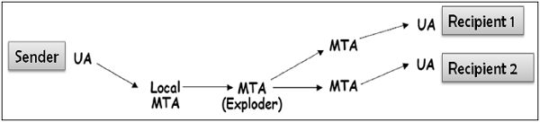
One-to-Distribution List E-mail
In this scenario, the sender sends an e-mail message to two or more recipients
but the list of recipients is not managed locally by the sender.
Generally, the e-mail server (MTA) maintains the mailing list.
The sender sends a mail to the MTA managing the mailing list and then the mail is
exploded by MTA to all recipients in the list.
The exploder encrypts K_{S} with as many public keys as there are members in the list.
The Exploder forwards the received encrypted message
and corresponding encrypted K_{S} to all recipients in the list.
For example, the Exploder forwards the encrypted message and R1_{PUB}(K_{S}) to recipient 1 and so on.

Slide 18
In this case, when the sender wants to send a confidential e-mail to the recipients of the mailing list (say R1, R2, and R3); the privacy is ensured as follows −
The sender and all recipients have their own pair of private-public keys. The Exploder Server has a pair of private-public key for each mailing list (List_{PUB}, List_{PVT}) maintained by it.
The sender generates a secret symmetric key K_{s} and then encrypts the message with this key.
The sender then encrypts K_{S} with the public key associated with the list, obtains List_{PUB}(K_{S}).
The sender sends encrypted message and List_{PUB}(K_{S}). The exploder MTA decrypts List_{PUB}(K_{S}) using List_{PVT} and obtains K_{S}.

Slide 19
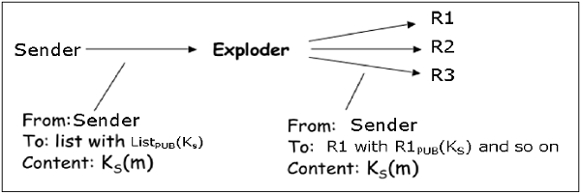
For providing the message integrity, authentication, and non-repudiation the steps to be followed are similar as given in case of one-to-one e-mail scenario.
Interestingly, the e-mail program employing above security method for securing e-mail is expected to work for all the possible scenarios discussed above. Most of the above security mechanisms for e-mail are provided by two popular schemes, Pretty Good Privacy (PGP) and S/MIME. We discuss both in the following sections.

